Slide 1
Group Work 3
Reflecting on Working in Teams
Learning Development

Slide 2
Learning outcomes
Identify previous experiences of working in a group/team
Explore reflective models in relation to group/team work
Reflect on previous participation in group/team work

Slide 3
Previous experiences of group/team work
Think about your previous experiences of working in a group/team. Select an experience and make brief notes or jot down key words in response to the following questions
What stands out as areas you did well?
What areas do you think you can develop?

Slide 4
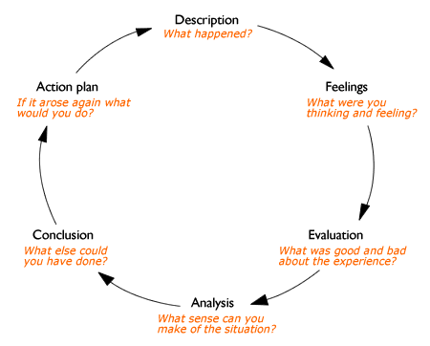
Gibb’s (1988) Reflective model

Slide 5
Reflecting on group/team participation
As mentioned earlier it’s useful to reflect about your previous participation in group/team work to inform how you can improve your productivity in the future.
Look at the Reflecting on Working in Teams worksheet and complete the cycle in line with your experience.

